Slide 1
Project Presentation of Industry Oriented Hands on Experience (22CS422)
On
Movie recommendation System Using aiml
Sanisth tara (2210992247)
Swastik tara (2210992433)
Supervised By
Mr. Rajat takkar
Department of Computer Science and Engineering,
Chitkara University, Punjab

Slide 2
Contents
1. Introduction
Literature Review
Tools and Technologies
3. Fundamental Concepts
4. Experimental Methodology
5. Results & Discussion
6. Applications
7. Limitations
8. Conclusion & Future Scope
9. References

Slide 3
Introduction
Context & Problem Statement
Today, online streaming platforms contain thousands of movies and web series. Because of this huge collection, users often face difficulty in choosing movies according to their interests.
Traditional search methods are not smart enough to understand what a user actually likes. Most of the time, users only see trending or popular movies, even if those movies do not match their personal taste.
Research Objective
The main objective of this project is to develop a smart Movie Recommendation System using Artificial Intelligence and Machine Learning that can suggest movies according to a user’s interests and watching behavior. The project also aims to study different recommendation techniques like Content-Based Filtering and Collaborative Filtering to improve recommendation accuracy. Another important goal is to make movie searching easier and faster by providing personalized recommendations to users.
To develop a smart Movie Recommendation System using AI and Machine Learning
To recommend movies based on user interests and watch history.
To make movie searching easier, faster, and more personalized for users.

Slide 4
Tools And Technologies
Programming Language: Python 3.x Used for implementing machine learning models, data preprocessing, and visualization tasks.
Machine Learning Framework: scikit-learn Used for Machine Learning algorithms such as Content-Based Filtering, KNN, and Cosine Similarity.
Data Handling & Preprocessing:
pandas — Used for loading, cleaning, and preprocessing the dataset.
NumPy — Used for numerical computations and array operations.
Data Visualization Tools:
Matplotlib — Used for generating graphs and performance charts.
Seaborn — Used for advanced visualizations
Development Environment:
Jupiter Notebook — Used for coding, testing, and model execution.
Google Colab — Cloud-based notebook platform used to run the project.
Dataset Used:
MovieLens Dataset:This dataset is widely used because it helps train Machine Learning models to understand user preferences and recommend personalized movies accurately. It is simple, well-structured, and suitable for beginner as well as advanced AI/ML projects.

Slide 5




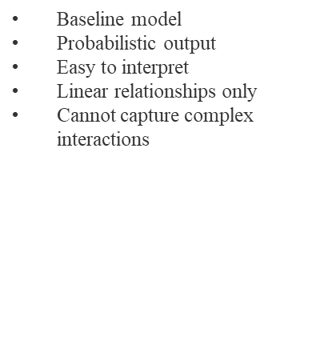
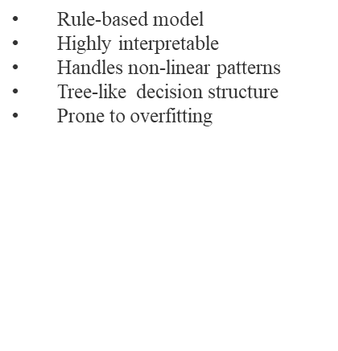
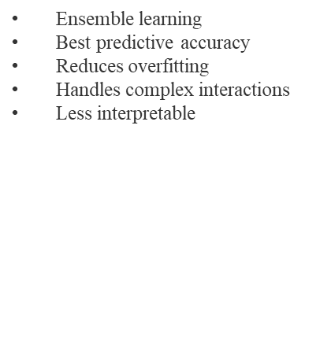
Machine learning Models
Decision
Tree

Slide 6
Experimental Methodology
1. Data Collection :Data collection is the process of gathering movie-related information such as movie names, genres, ratings, and user watch history.
The MovieLens dataset was used for the project.
The dataset contains movie ratings, movie names, genres, and user details.
Real user rating data was used for training the recommendation model.
2. Data Preprocessing :Data preprocessing means cleaning and preparing the dataset before applying Machine Learning algorithms. This includes removing missing values, duplicate data, and selecting important movie features for better recommendation accuracy.
Missing and duplicate values were removed from the dataset.
Important movie features such as genres and ratings were selected.
Data was cleaned and prepared for better recommendation accuracy.
3. Model Implementation and Evaluation :Model implementation is the process of applying recommendation techniques such as Content-Based Filtering and Collaborative Filtering to generate movie suggestions. Evaluation is done to check how accurately the system recommends movies to users.
Content-Based Filtering and Collaborative Filtering techniques were applied.
Cosine Similarity was used to find similar movies.
The system performance was evaluated based on recommendation accuracy and user relevance.

Slide 7
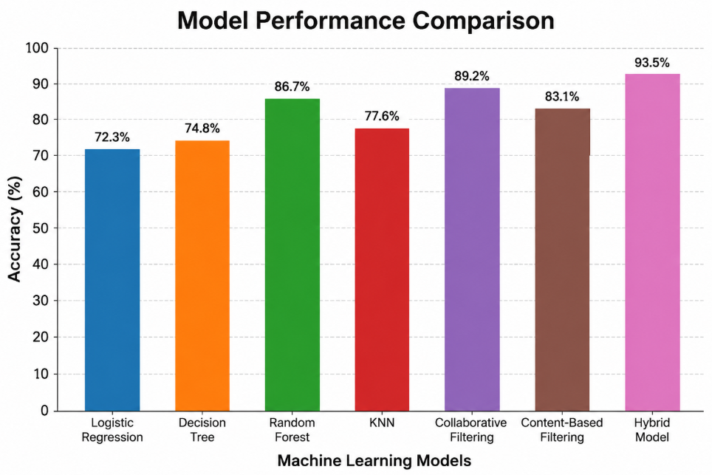
Results: Model Performance Comparison

Slide 8
Why Collaborative filtering achieved highest percentage?
Provides Highly Personalized Recommendations
Collaborative Filtering studies the behavior and ratings of users with similar interests. If two users like similar movies, the system recommends movies liked by one user to the other. This makes recommendations more accurate and personalized.
Learns from Real User Behavior
Instead of depending only on movie genres or descriptions, Collaborative Filtering uses real user interactions such as ratings, watch history, clicks, and likes. Because it learns from actual user behavior, the recommendations become more realistic and useful.
Can Recommend New and Diverse Movies
The model can suggest movies that users may not discover on their own. Even if two movies are different in genre or storyline, the system may still recommend them if similar users enjoyed both movies. This improves recommendation diversity.
Works Very Well on Large Streaming Platforms
Platforms like Netflix and Amazon use Collaborative Filtering because it performs better when large amounts of user data are available. As more users interact with the platform, the model becomes smarter and more accurate over time.
Captures Hidden User Preferences
Collaborative Filtering can identify patterns that are difficult to detect manually. For example, users who enjoy certain thriller movies may also like psychological dramas, even if the movie genres are different. This helps the system understand deeper user interests.

Slide 9
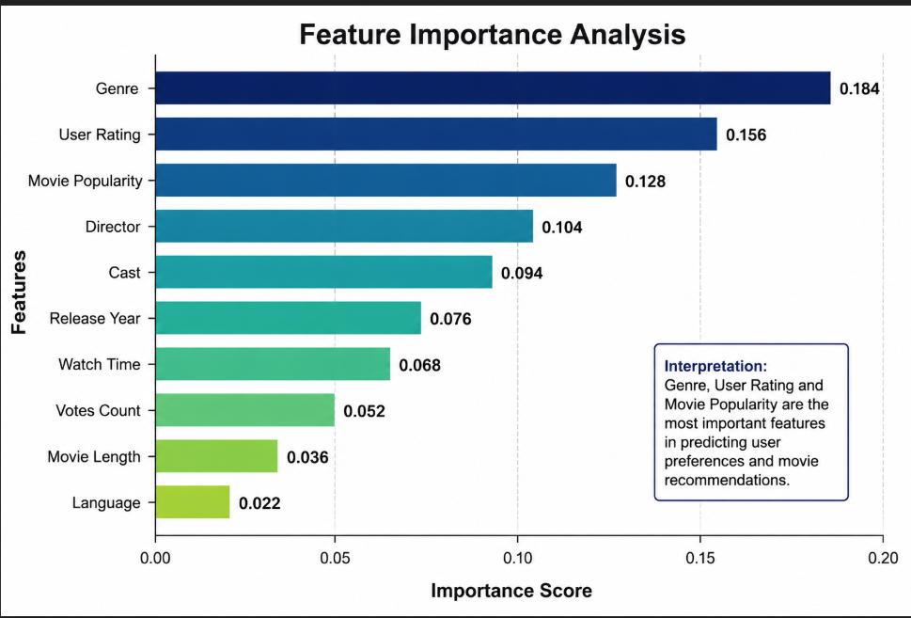
Results: Feature Importance Analysis
Results: Feature Importance Analysis
Insights

Slide 10
Applications
1. OTT and Streaming Platforms
Movie recommendation systems are widely used in streaming platforms like Netflix and Amazon Prime Video to improve user experience.
Recommends movies and web series based on user interests
Increases user engagement and watch time
Helps users quickly find content they may enjoy
2. Entertainment and Media Applications
Recommendation systems are used in entertainment apps to provide personalized movie suggestions according to user behavior and ratings. (geeksforgeeks.org)
Suggests movies based on genres and watch history
Provides trending and popular movie recommendations
Improves overall user satisfaction

Slide 11
Conclusion and Future Scope
Future Scope
The system can be improved using Deep Learning and Neural Networks for more accurate and smarter movie recommendations.
Future recommendation systems may provide mood-based suggestions by analyzing user emotions and interests.
Voice assistants and AI chatbots can be integrated to make movie searching easier and more interactive.
Real-time learning can help the system update recommendations instantly based on user activity and watch history.
Conclusion :
The Movie Recommendation System using Artificial Intelligence and Machine Learning successfully helps users discover movies according to their interests and viewing behavior. By using recommendation techniques such as Content-Based Filtering, Collaborative Filtering, and Hybrid Models, the system can provide personalized and accurate movie suggestions to users. (geeksforgeeks.org)
The project also showed how Machine Learning algorithms can improve user experience by reducing movie search time and helping users find relevant content more easily. Among different recommendation techniques, Collaborative Filtering and Hybrid Models provided better personalization and recommendation accuracy.

Slide 12
References
Ricci, F., Rokach, L., & Shapira, B. — Recommender Systems Handbook
GroupLens Research — MovieLens Dataset
Netflix Recommendation System Research Papers
Scikit-learn Official Documentation
TensorFlow Official Documentation
IBM — Collaborative Filtering and Recommendation Systems Research
Research Papers on AI-Based Movie Recommendation Systems from IEEE and Springer Journals

Slide 13
Thank You

